Slide 1
BCCC Testing Information
Building 8 – Room 823
Photo ID Required
Arrive 15 Minutes Early for Paperwork
Scrap Paper/Formula Sheet/Calculators Provided
For testing availability and to reserve your seat,
call 252-940-6375 – 24 hours notice required.
Limited seating available.
Retrieve scores at: myworkkeys.com
National Career Readiness Certification

Slide 2
Find your NCRC Certificate and individual assessment scores at: https://myworkkeys.act.org/mwk/login.do?event=go&realm
Problems with accessing your scores?
Call the ACT Customer Service Line:
319-337-1380
NCRC Certificates Printed through ACT at myworkkeys.com

Slide 3
The National Career Readiness Certification consists of the Applied Math, Graphic Literacy, and Workplace Documents assessments.
Scholarships Available!
Assessment Topic | BCCC Price | Time Estimate
Applied Math | $13 | 1 hour
Graphic Literacy | $13 | 1 hour
Workplace Documents | $13 | 1 hour

Slide 4
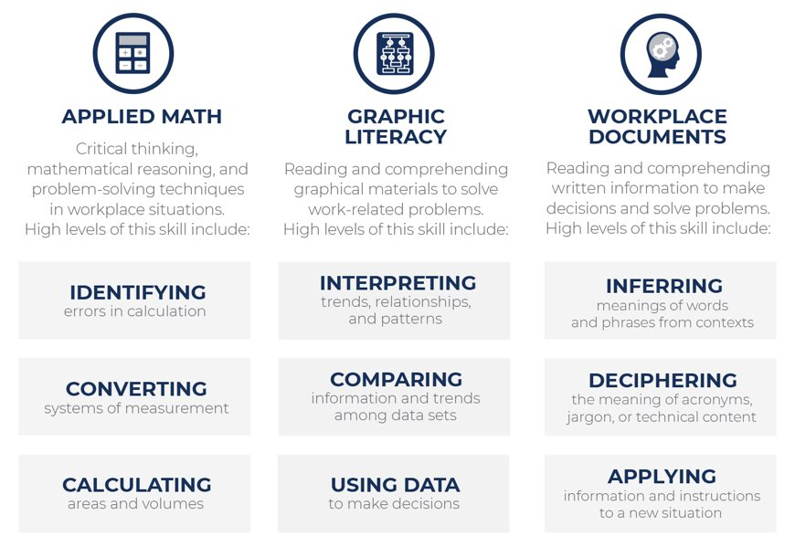
What Does the NCRC Test?
Cognitive Skills Measured by WorkKeys®

Slide 5
The NCRC is awarded at four levels. Higher levels indicate a greater number of jobs for which a recipient is qualified.
​
Platinum indicates the skills required for approximately 96% of ACT-profiled jobs​ Levels 6 and 7
Gold indicates the skills required for approximately 90% of ACT-profiled jobs Level 5
Silver indicates the skills required for approximately 71% of ACT-profiled jobs​ Level 4
Bronze indicates the skills required for approximately 16% of ACT-profiled jobs​ Level 3
​

Slide 6
Prepare for the NCRC by joining our BCCC Employment Learning Lab! The B.E.L.L. will grant you access to a Practice NCRC Assessment and online learning modules on each of the skills tested by the NCRC. This lab is free to those who qualify for an HRD Fee Waiver and can be joined at any time.
For more information on NCRC Skills and Levels, continue through slides 7-25.
For other ACT Assessments available at BCCC, please see slide 26.
For Beaufort County Businesses Recognizing the NCRC, please see slide 27.

Slide 7
Level | Characteristics of Items
3 | ►Translate easily from a word problem to a math equation ►All needed information is presented in logical order ►No extra information
4 | ►Information may be presented out of order ►May include extra, unnecessary information ►May include a simple chart, diagram, or graph
5 | ►Problems require several steps of logic and calculation (e.g., problem may involve completing an order form by totaling the order and then computing tax)
6 | ►May require considerable translation from verbal form to mathematical expression ►Generally require considerable setup and involve multiple-step calculations
7 | ►Content or format may be unusual ►Information may be incomplete or implicit ►Problems often involve multiple steps of logic and calculation

Slide 8
Sample Skills and Levels
Applied Math
Level 3 | Level 5
Solve problems requiring one type of mathematical operation Convert fractions, decimals, and percentages Convert familiar units of money and time Add prices of several products together and calculate correct change | Decide what information, calculations, or unit conversions to use to find the answer to a problem Add and subtract fractions with unlike denominators Convert units within or between systems of measurement (e.g., time, measurement, quantity) where the conversion factor is provided Identify where a mistake occurred in a calculation

Slide 9
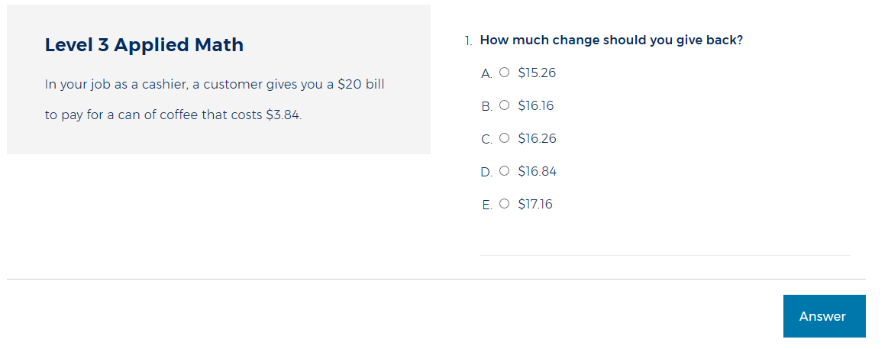
Applied Math Sample Items
Notes:
Answer will appear on click

Slide 10
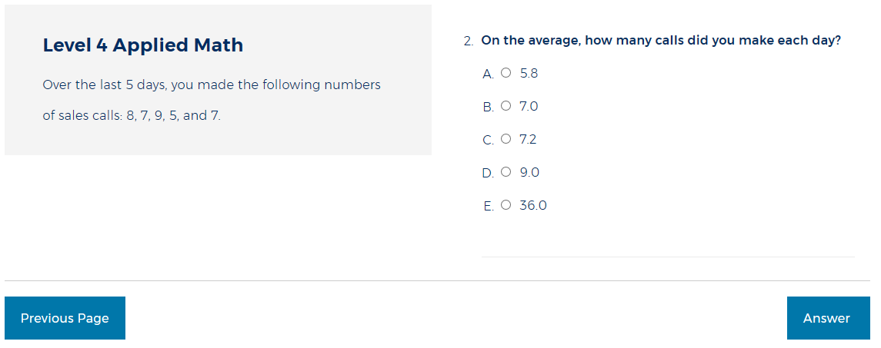
Applied Math Sample Items
Notes:
Answer will appear on click.

Slide 11
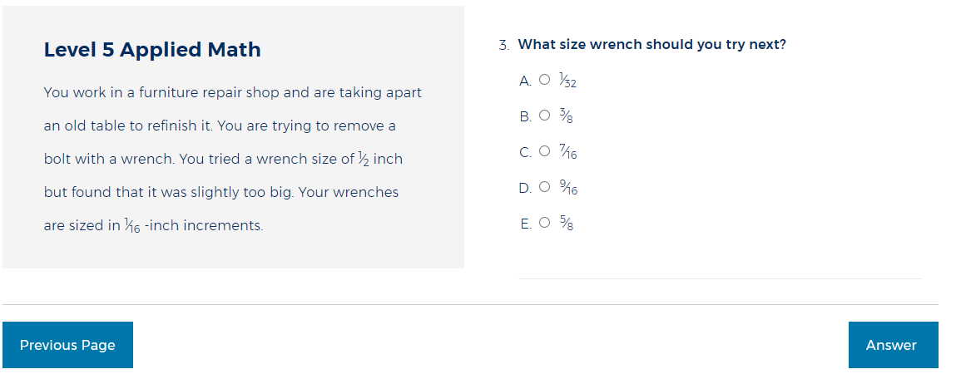
Applied Math Sample Items
Notes:
Answer will appear on click.

Slide 12
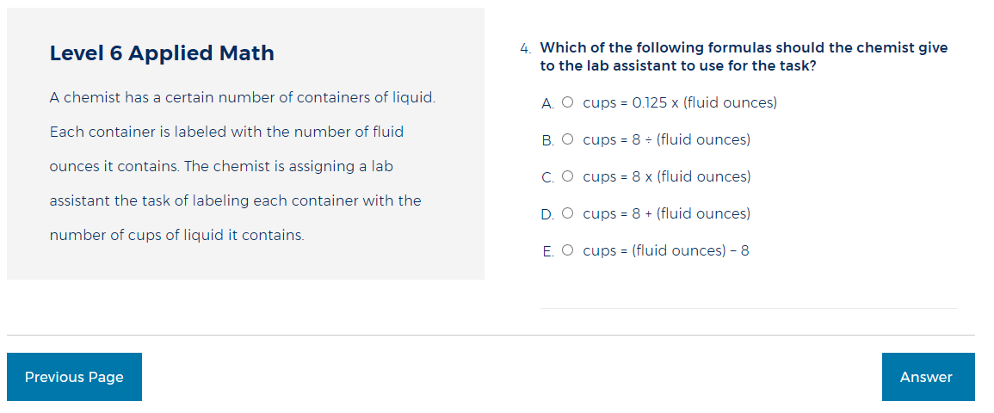
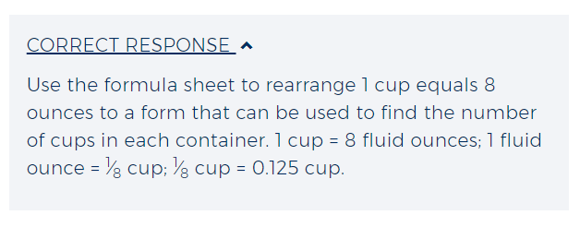
Applied Math Sample Items
Notes:
Answer will appear on click.

Slide 13
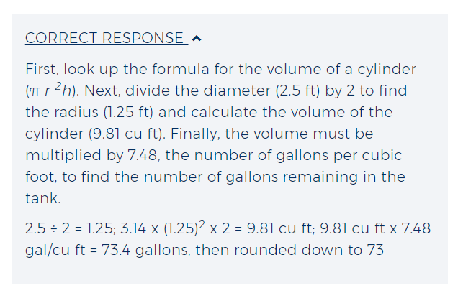
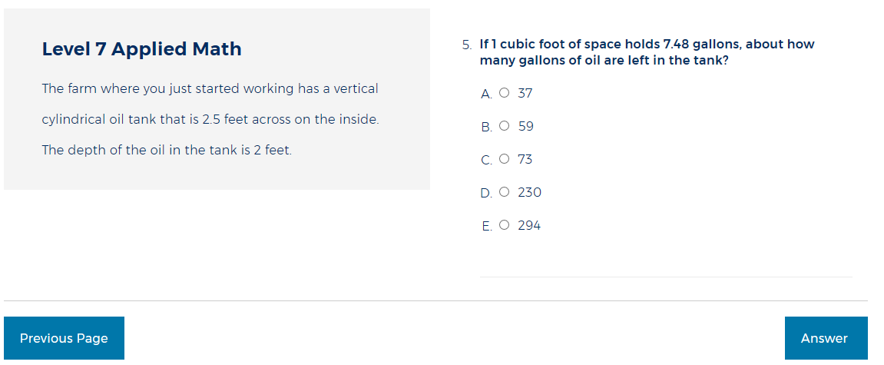
Applied Math Sample Items
Notes:
Answer will appear on click.

Slide 14
Level | Characteristics of Items
3 | ►Elementary workplace graphics such as simple order forms, bar graphs, tables, flowcharts, maps, or floor plans ►One graphic used at a time
4 | ►Straightforward workplace graphics, such as order forms, bar charts, pie charts, diagrams, flow charts, maps, and dashboards ►May include multiple levels of data within a graph ►One or more graphics are used at a time
5 | ►More complicated workplace graphics –unusual graphic types ►Multiple variables and densely displayed information
6 | ►Very complicated and detailed graphs, charts, tables, forms, maps, and diagrams ►Contain large amounts of information, multiple graphics ►May include three axes and different scales within one graphic
7 | ►Extremely complex, dense graphics (often multiple graphics)

Slide 15
Sample Skills and Levels
Graphic Literacy
Level 4 | Level 5
Locate information in a graphic using information found in a second graphic Compare two or more pieces of information Identify a trend/pattern/relationship Make an inference or decision Identify the graphic that accurately represents the data | Locate information in a graphic using information found in another graphic Interpret trends/patterns/relationships Make a reasonable inference or decision based on one graphic after finding information in another graphic Identify the graphic that accurately represents the data Identify and justify the most effective graphic given a defined purpose

Slide 16
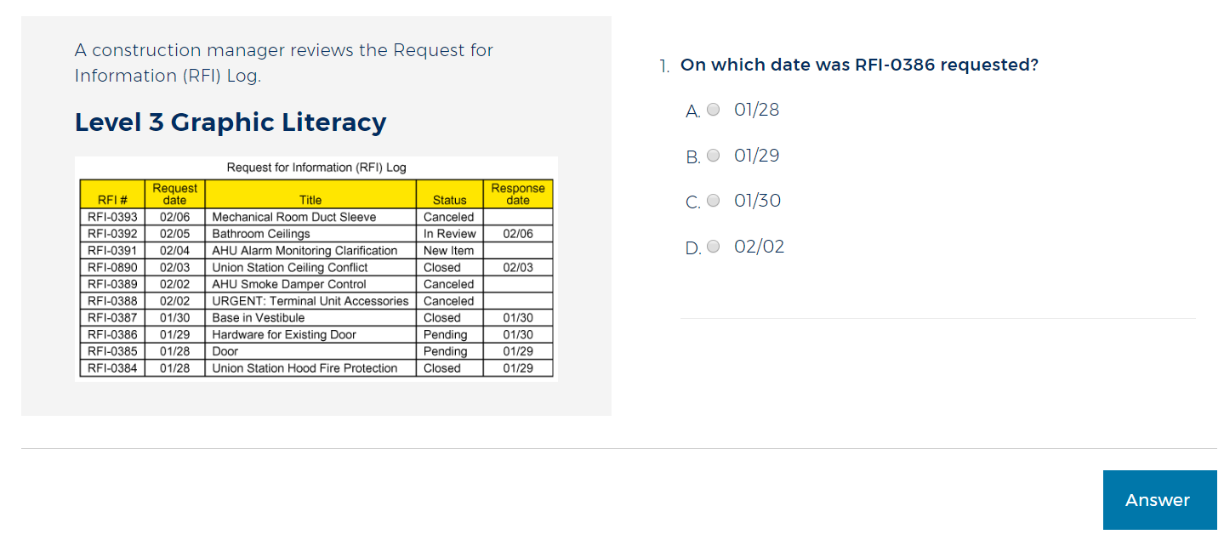
Graphic Literacy Sample Items
Notes:
Answer will appear on click.

Slide 17
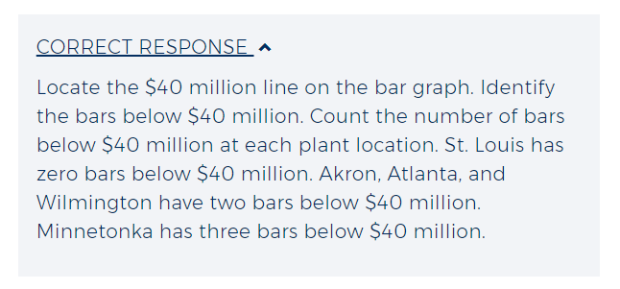
Graphic Literacy Sample Items
Notes:
Answer will appear on click.

Slide 18
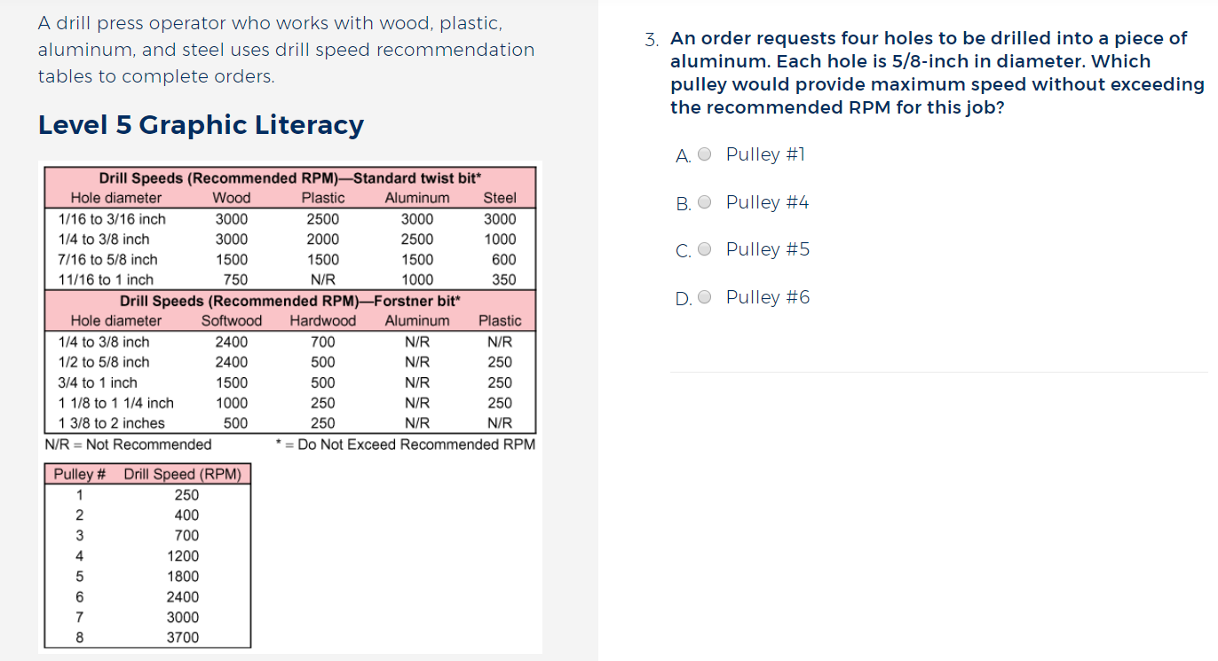
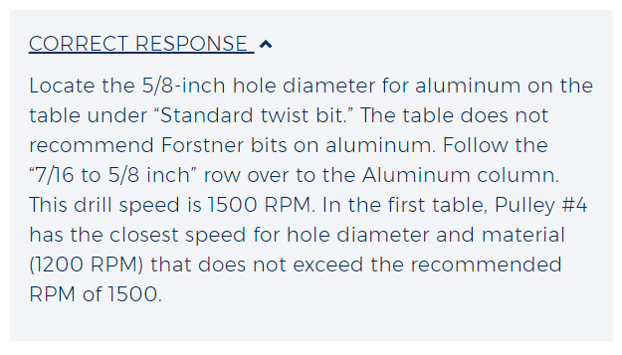
Graphic Literacy Sample Items
Notes:
Answer will appear on click.

Slide 19
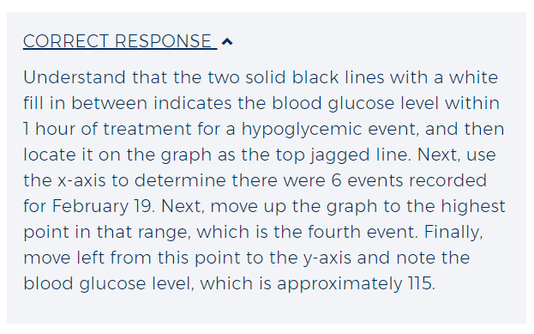
Graphic Literacy Sample Items
Notes:
Answer will appear on click.

Slide 20
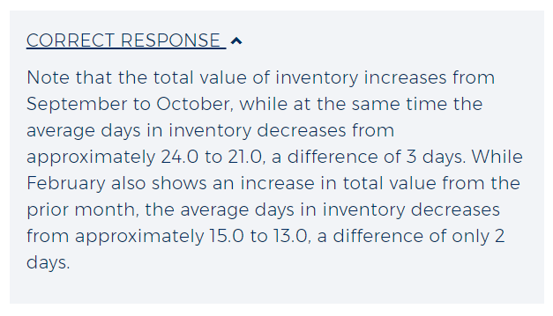
Graphic Literacy Sample Items
Notes:
Answer will appear on click.

Slide 21
Level | Characteristics of Items
3 | ►Reading materials include basic company policies, procedures, and announcements ►Reading materials are short and simple, no extra information ►Reading materials tell readers what they should do ►All needed information is stated clearly and directly ►Items focus on the main points of the passages ►Wording of the questions and answers is similar or identical to the wording used in the reading materials
4 | ►Reading materials include company policies, procedures, and notices ►Reading materials are straightforward but have longer sentences and contain a number of details ►Reading materials use common words but do have some harder words, too ►Reading materials describe procedures that include several steps ►When following the procedures, individuals must think about changing conditions that affect what they should do ►Questions and answers are often paraphrased from the passage

Slide 22
Level | Characteristics of Items
5 | ►Reading materials include informational, instructional, policy, contracts, and legal documents ►Longer passages that include multiple details and extraneous information ►Documents may include unfamiliar vocabulary, professional jargon, and acronyms ►Figure out the correct meaning of a word based on how the word is used ►Apply technical terms and jargon and relate them to stated conditions ►Written materials include conditionals (e.g., if-then statements)
6 | ►Reading materials include informational, instructional, policy, contracts, and legal documents ►Longer passages that include complex sentences, difficult vocabulary, professional jargon, and acronyms ►Meaning of terms may be implied and their meaning will need to be determined from context ►Extraneous details ►Written materials include extraneous details and conditionals (e.g., if-then statements)

Slide 23
Level | Characteristics of Items
7 | ►Very complex reading materials ►Information includes a lot of details ►Complicated concepts ►Difficult vocabulary ►Unusual jargon and technical terms are used but not defined ►Writing often lacks clarity and direction ►Readers must draw conclusions from some parts of the reading and apply them to other parts

Slide 24
Sample Skills and Levels
Workplace Documents
Level 4 | Level 7
Identify main idea and specific details Use the information in the document to figure out the meanings of words or phrases that are not defined for them Choose when to perform a step in a series of steps Apply information/instructions to a situation that is the same as the situation described in the document Choose what to do when changing conditions call for a different action | Infer implied details Infer meaning of an acronym, jargon, or technical term from context Apply principles inferred in a passage to a situation not directly described in the document or to a completely new situation Identify the rationale behind an entire document or a section of a document

Slide 25
Workplace Documents Sample Items
Sample items for Workplace Documents can be found here:
https://www.act.org/content/act/en/products-and-services/workkeys-for-job-seekers/preparation/reading-for-information.html?page=0&chapter=0

Slide 26
Other ACT Assessments Available
Assessment Topic | BCCC Price
Applied Technology | $15
Talent Assessment | $16
Fit Assessment | $16
Business Writing | $22
Workplace Observation | $22

Slide 27
Beaufort County Businesses Recognizing the NCRC
Wilkes Communications
NACCO Materials Handling Group
The Roberts Company
Domtar Personal Care
ASMO
DSM Dyneema
Suddenlink
Pitt Community College
Vidant Health
Pitt County Government
Greenville Utillities Commission
City of Greenville NC
Patheon
Ann's House of Nuts
Spinrite Services
Beaufort County Community College
PotashCorp
Beaufort County Schools
Tideland Electric Membership Corporation
National Spinning Co. Inc.
Flanders Corporation
Scoops Ice Cream Inc.
Coles Electric Motor Shop
City of Washington
Russell's Gentlemens Clothing
VT Hackney
Beaufort County Government
Washington Montessori Public Charter School
Inner Banks Tea Company
One Source Communications
Carolina Technical Plastics Corp
First South Bank
Blue Arbor Inc.
PAS USA Inc.
idX Impressions
Holden Temporaries Inc.
Mid-East Commission
Pantego Plantation Gourmet Foods
Roebuck Staffing Company
Dudley Landscaping & Tree Service
Mega Force Staffing Group
Clarcor
Greene Lamp Community Action
Jernigan Oil Company Inc.
Duck Thru Food Stores
Regino Q Workforce Development Board
Carteret General Hospital
Beaufort County DSS
Domtar Paper Company - Plymouth Mill
Carver Machine Works Inc
Professional Staffing Solutions LLC
ITW Medical - Coeur
Camfil USA Inc.
Pippin Resource Group
Ready Hire Staffing
Eastern Radiologists Washington
Ruth's House
Kirlin Carolina's
Bosch Siemens Home Applicance Group
NC Division of Vocational Rehabilitation
Carolina Store Fixtures
Precision Pallet LLC
Syfan USA
Beaufort County Economic Development
Oak Ridge Industries
Mid-East Commission
SERVPRO of Bath
Carver Machine Works Inc.
River City Construction
Washington-Beaufort County Chamber of Commerce
Vidant Beaufort Hospital
Beaufort County NCWorks Career Center
Beaufort County Economic Development
Region Q Workforce Development Board
Cole's Electric Motor Shop
Mayo Appliance Solutions
Main Street Scoops
Radcliffe Marine Inc
Fish Hooks Cafe
Jarrett Bay Boatworks

